Slide 1




Post-Mid-Size Asteroid Impact Long-term Flooding Hazards
Lucienne Morton, NAU/USGS Astrogeology Science Center
Timothy Titus, USGS Astrogeology Science Center

Slide 2
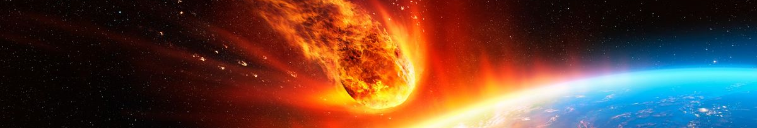
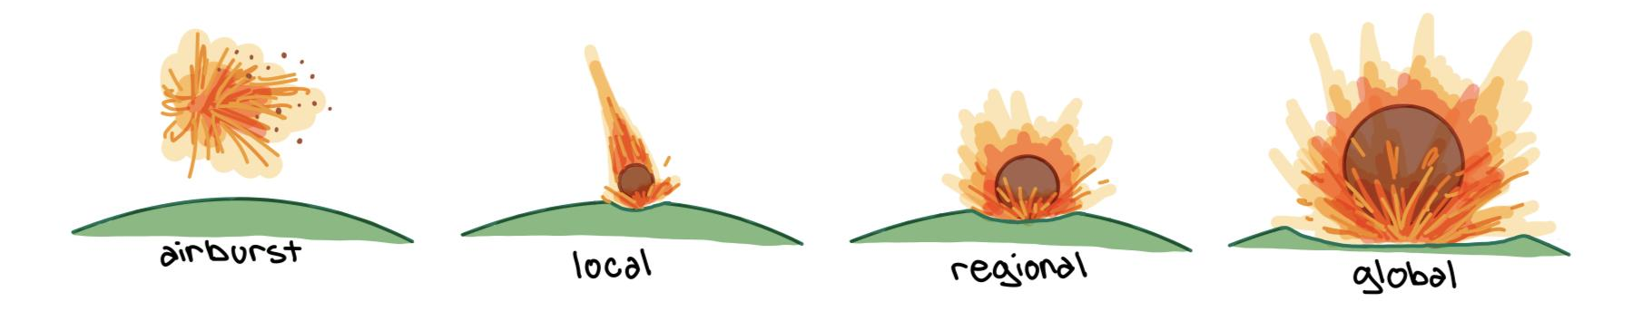
Background
https://www.livescience.com/space/asteroids/could-scientists-stop-a-planet-killer-asteroid-from-hitting-earth
Asteroids!
  Different sizes = Different effects
  Burn up in atmosphere vs. small-scale impact vs. mass extinction
First-wave impact effects
  Airblast
  Thermal radiation
  Ash plume

Slide 3
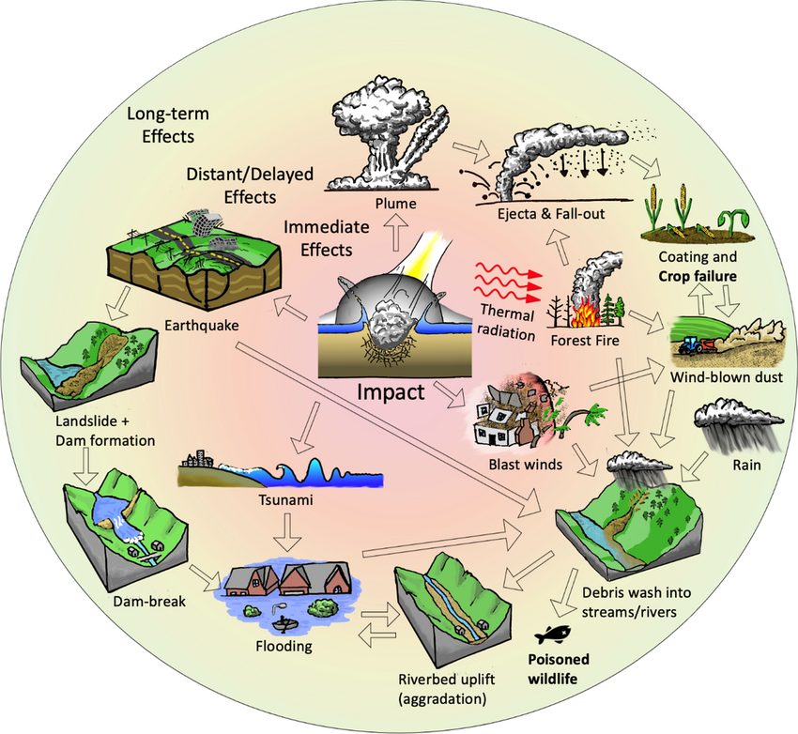
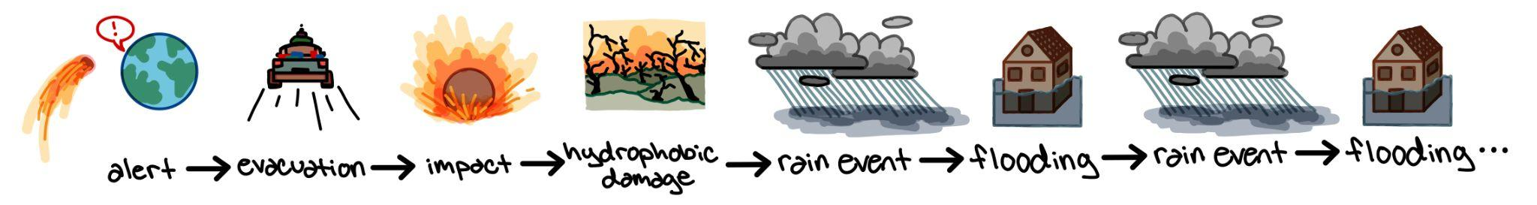
Mid-Sized Asteroid Cascading Hazards
What is a cascading hazard?
  A primary disaster event causing a chain of secondary hazards
  Ex: an earthquake triggering landslides
Analogous events
  Wildfire
  Volcano
  Earthquake
Associated cascading hazards
  Wildfire > hydrophobic soil + lack of vegetation > increased rate of flooding
Titus et. al, 2022

Slide 4
Our Project
The Objective
  Create a simplified model to estimate a total affected population based on:​
    Various hydrophobic radii caused by a mid-size asteroid impact​
    Post-impact rainfall events​
The Question
  How sensitive is the number of people affected from post-impact flooding based on the thermally radiated hydrophobic radius?
The Approach
  Use GeoCLAW to calculate flood depth data in various river basins, compare with population map to gain a total affected population

Slide 5
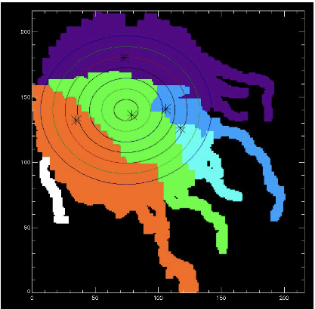
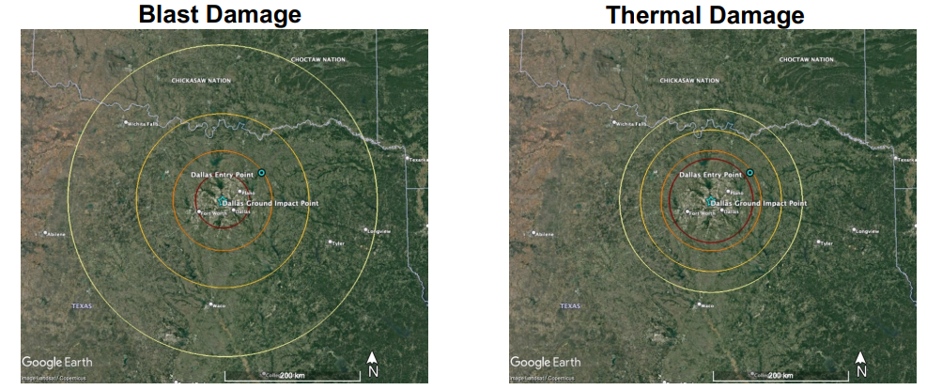
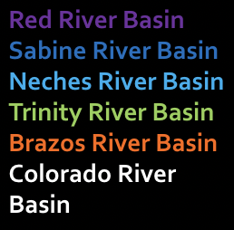
Our Scenario
Mid-size asteroid (~800 m diameter at 10.3 GT)
  Previously thought to be just short of global effects
  Tsar Bomba: 50-58 MT, largest above-ground nuclear detonation
Hypothetical impact:
  Location: Dallas Fort Worth, TX
  Date/time: October 22nd, 2036 15:04 UTC
Assumed evacuation of people within the 2-psi blast radius
Wheeler et. al 2022

Slide 6
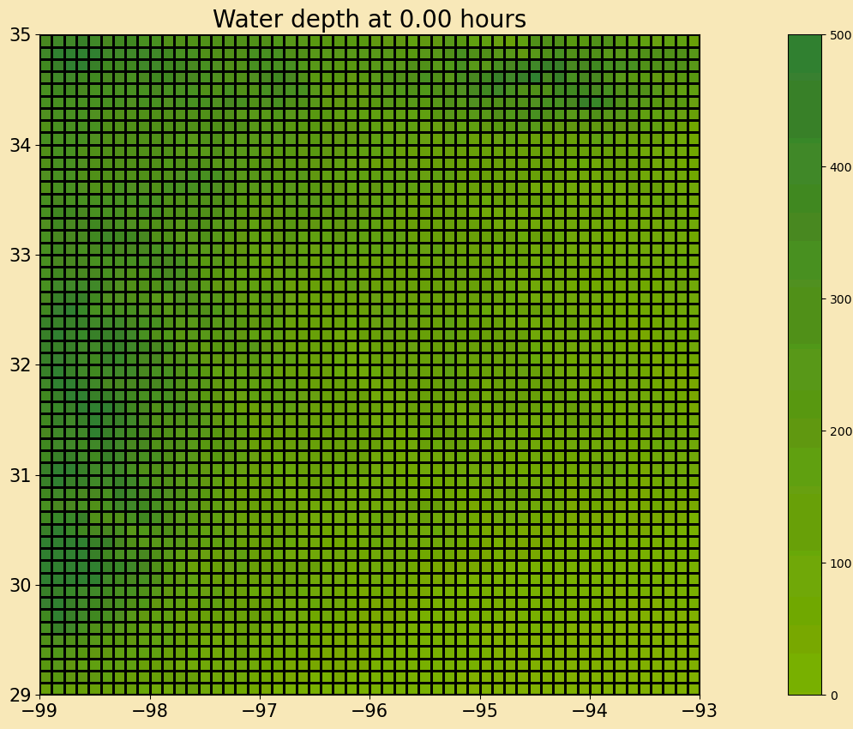
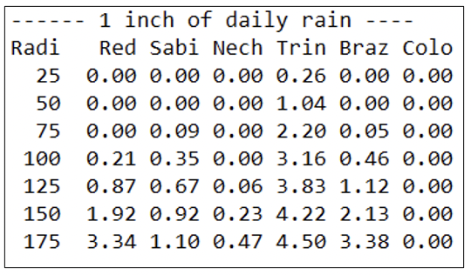
GeoCLAW
Description
  Solves for 2D depth-averaged shallow water equations for flow over varying topography
  Typically used for tsunamis, storm surges, other overland floods
Our Use
  Calculate the flood depth in a set of river basins based on various rainfall rates and hydrophobic radii
Caveats
  Spring in place of rainfall
  lack of infiltration, base flow, sediment flux, evaporation, transpiration, etc

Slide 7
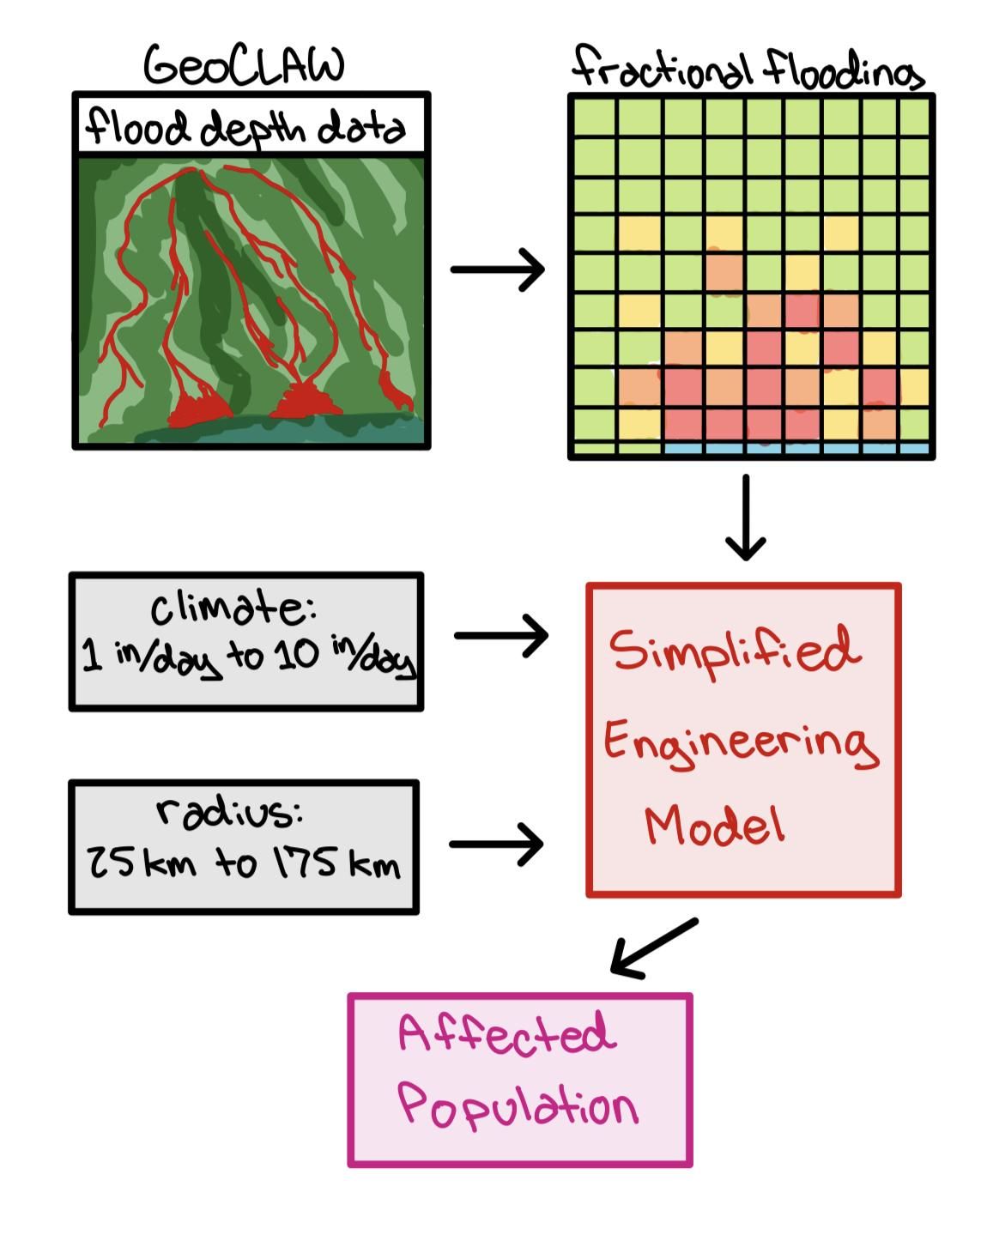
Methodology: GeoCLAW Output & Population Comparison
GeoCLAW model output converted to affected population
  Flood depth data input to higher resolution map to calculate fractionally flooded areas
    Ex: 25% flooded pixel
  Compared with population map to calculate people affected based on flood fraction
    Ex: 25% flooded pixel * 1000 residents = 250 affected people
Tested Scenarios
  Rain events: 1 inch to 10 inches per day​
  Hydrophobic radius: 25 km to 175 km, 25 km intervals​

Slide 8
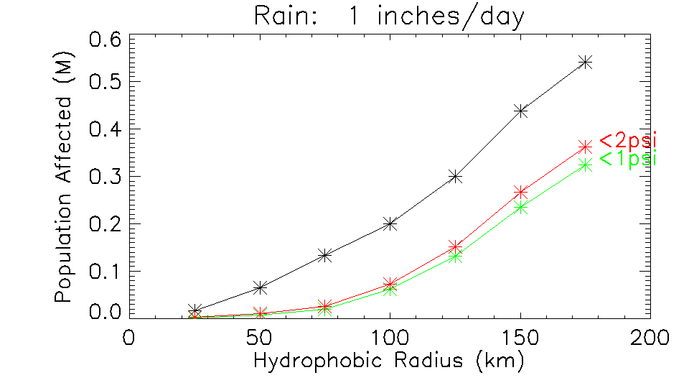
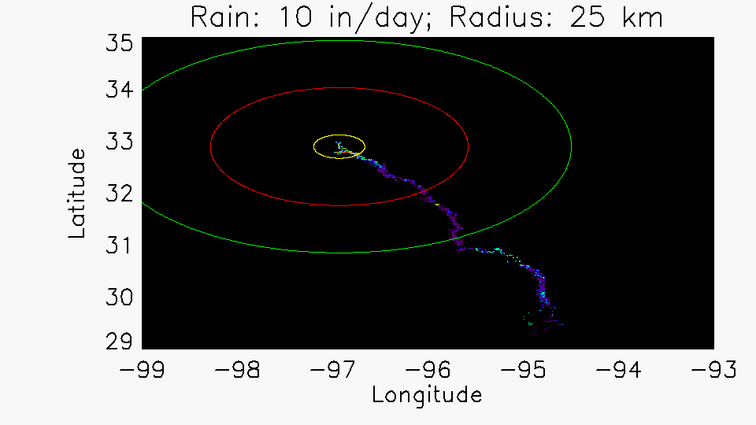
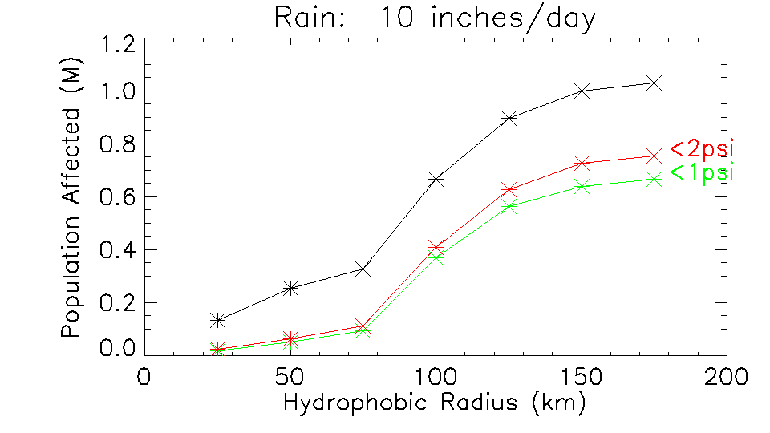
Population Results
Highlights
  Population plateau - saturation of river basins
  Inflection point - crossing over to multiple basins
  Most likely case: ~50,000 people/event
  Worst case: ~600,000 people/event

Slide 9
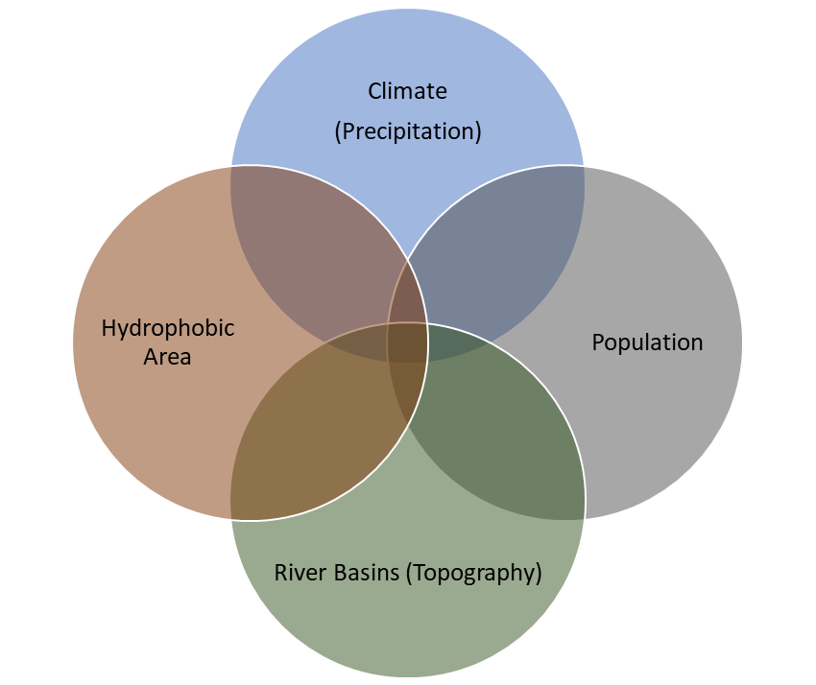
Conclusion
Summary
  A total affected population was calculated at various:
    hydrophobic radii (unknown)
    climate scenarios (rainfall events)
  Flood damage extends beyond evacuation radius
  Worst case affected population is roughly twelve times higher than most likely case
Main takeaways
  Non-evacuees will likely be affected by long-term flooding
  Location and extent of hydrophobic damage matters
  Number of affected river basins matters
  Population distribution matters

Slide 10
Thank you! Questions?

